Slide 1
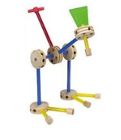
FPGA Timeline & Applications FPGAs past, present & future
Jim Brakefield

Slide 2
FPGA Application Areas
$6-7B yearly sales
Communications
DSP
Software-defined radio
Aerospace and defense systems
ASIC prototyping
Medical imaging
Computer vision
Speech recognition
Cryptography
Bioinformatics
Computer hardware emulation
Data Center: AI, NN, big data
Advantages:
Low NRE
Low volume products
Updates/patches
Parallelism
Portable code (RTL)
Soft dev || Hard dev
Early use of process nodes
Disadvantages:
ASICs are cheaper,
faster and lower power
in high volumes

Slide 3
Low End Applications
1.5-3mm pkg, 2K LUTs
.1Mb block RAM
Glue logic Connection of disparate devices to a uP
Last minute patches
Logic funnel Legacy design re-hosting
IP: pre-packaged modules
Soft core processors & peripherals (www.opencores.org)
20K LUTs, 40 DSPs,
1Mb block RAM

Slide 4
Mid-scale Applications
200K LUTs, 1K DSPs,
15Mb block RAM
Communications: Internet routers, Telephone switches, Protocol conversion
Signal Processing: Software defined radio, Camera, Audio, Video, Radar …
Test & Measurement: high speed A2D & D2A,
Big science: Super-collider, SETI, etc.
Aerospace: radiation hardened, military temperature range
SOC (System On a Chip): driverless vehicles

Slide 5
High End Applications
2.5M LUTs, 5K DSPs,
200Mb block RAM
ASIC (Applications Specific Integrated Circuit) emulation
High end weapons, who knows what else?
Super-computing coprocessor
Intel bought Altera
Wall street (high frequency trading)
AI/deep NN/data center acceleration

Slide 6
The Vendors
Xilinx: www.xilinx.com
Originated FPGAs, tried anti-fuse, flash & CPLD, now #1
Altera (now Intel): www.altera.com
Originally CPLDs, currently #2 in FPGAs.
Microsemi (was Actel): www.actel.com
Originally anti-fuse, then flash, now SRAM & flash based
Lattice Semiconductor: www.latticesemi.com
Offer tiny FPGA chips, diversifying away from FPGAs
uP with some programmable logic
Cypress (under PSoC): ARM + programmable IO
Atmel/Microchip: ibid.

Slide 7
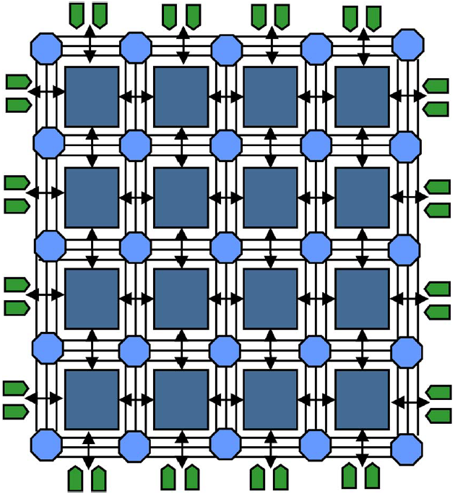
The FPGA
Generic FPGA diagram
Green: IOs
Squares: LUT
groups/slices/blocks
Octagons: Wiring
interconnections
Lines: Wire
segment bundles
From: Trimberger, 2015 Proc IEEE v103 #03 pg320

Slide 8
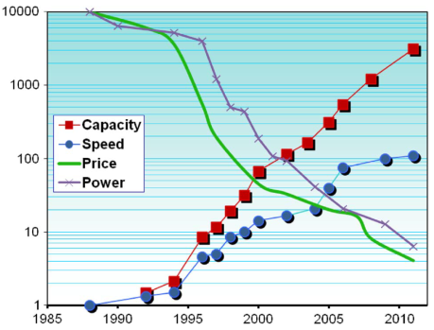
FPGA timeline
Not far off:
1GHz performance
7nm silicon
On chip DRAM
From: Trimberger, 2015 Proc IEEE v103 #03 pg318

Slide 9
Basic LUT (Look-Up Table)
Currently up to 2.5M LUTs
at 100-1000 LUTs/$
1985 LUTs plus DFF Xilinx XC2000
Clocking facilities
Configuration memory
Routing wires
1991 Carry chain Xilinx XC4000
LUT RAM (16x1)
Shift Registers

Slide 10
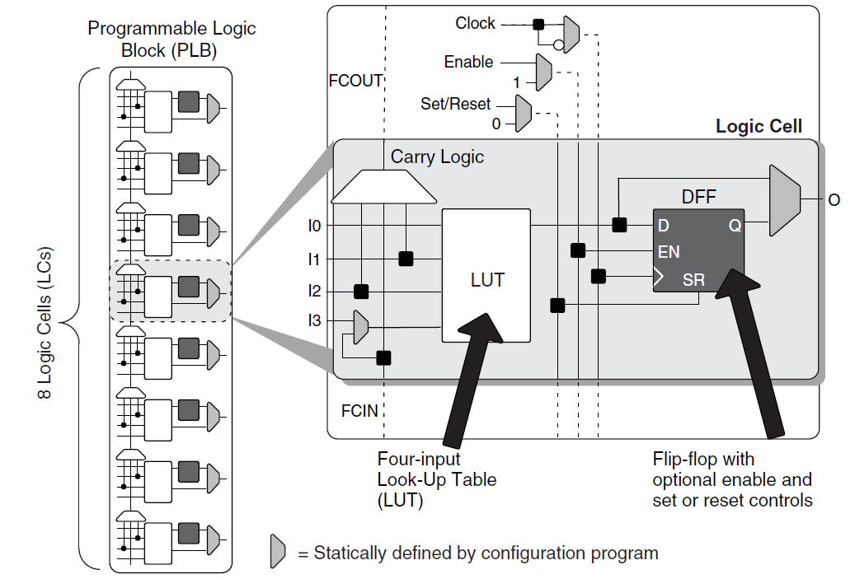
LUT + DFF
3LUTs tried
6LUTs in use
ALM: ~two
5LUTs
with
multiple
configurations
4LUT: 16 bits
of memory &
a 16:1 MUX
Lattice Semiconductor iCE40FamilyHandbook.pdf pg6-2

Slide 11
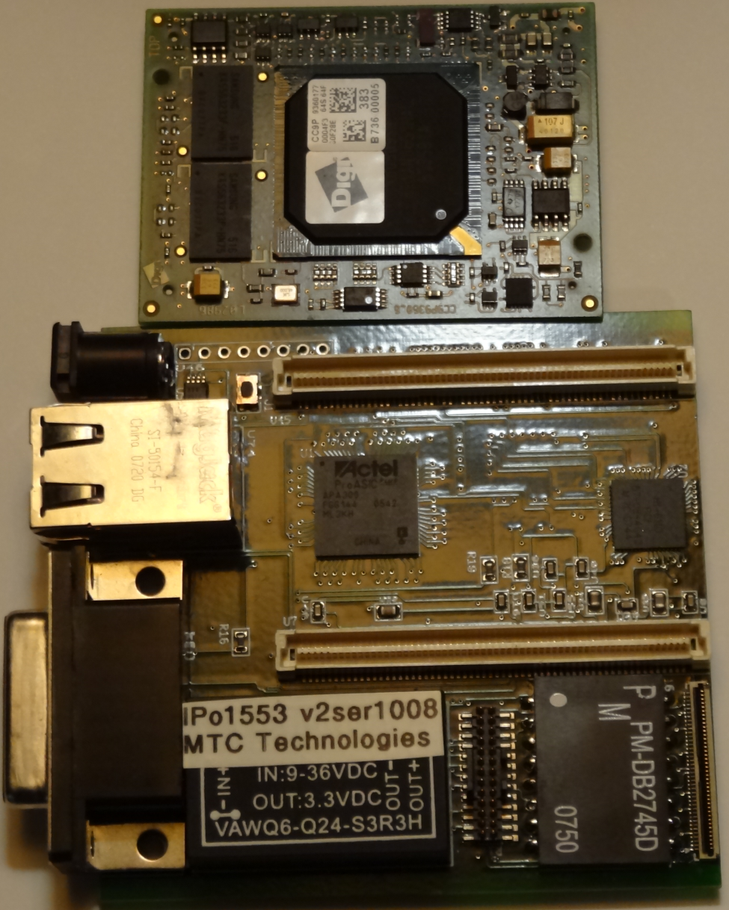
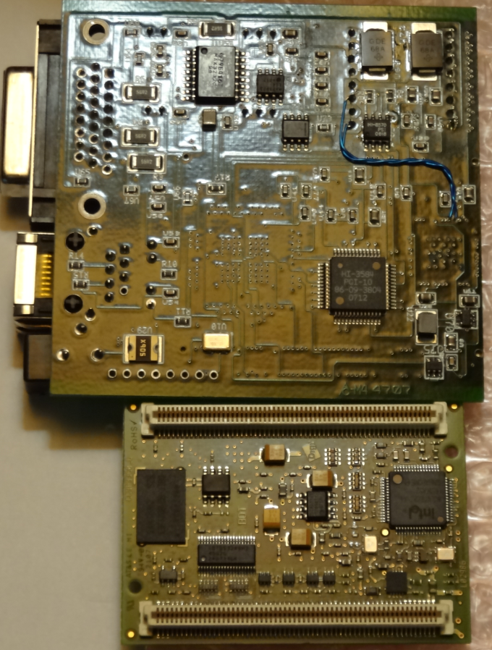
Uses:
“glue” logic
Reprogrammable (field changes)
Reliability
(parts count and wiring reduction)
IPo1553 module (BAE Systems): ARINC 429, MIL-STD 1553, RJ45, CAN

Slide 12
Block RAM
up to ~12K block RAMs
up to 480M bits
1995 Dual port RAM Altera FLEX
Variable aspect ratio (on each port)
16Kx1, 8Kx2, 4Kx4, 2Kx8/9, 1Kx16/18, 512x32/36
A variety of RAM capacities
LUT RAM (16x1), small block RAM (~32x18), block RAM (~512x36), large block RAM (~4Kx72)
Uses:
Buffers, FIFOs, shift registers, scratch pad memory, DSP coefficients, two single port RAMs, u-code

Slide 13
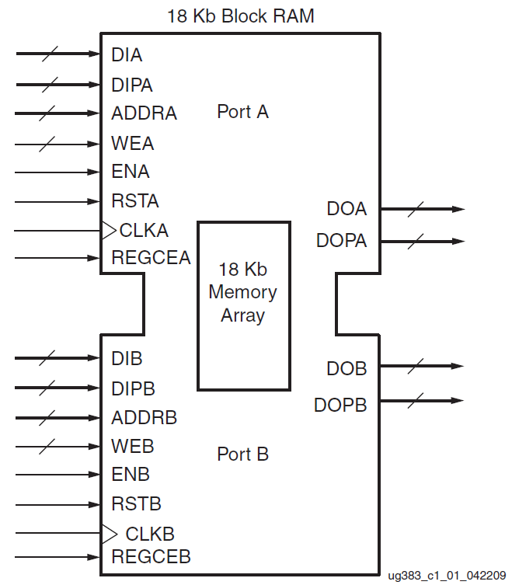
Block RAM
Parity bits
usable as
data bits
Data in
Parity data in
Address in
Write enable
Enable
Reset
Clock
Data out
Parity data out
Data in
Parity data in
Address in
Write enable
Enable
Reset
Clock
Data out
Parity data out
Xilinx Spartan-6 FPGA Block RAM Resources User Guide pg12

Slide 14
PLL (Phase Locked Loop)
FPGA internal clocks to 800MHz
1996 Altera FLEX 10K
FPGAs can have dozens of distinct clocks
All the analog (of the PLL) inside FPGA
Uses: Reduce chip count, precise clock phase control

Slide 15
“ASIC” IO
1998 Universal IO Xilinx Virtex
1.2, 1.8, 2.5, 3.3, 5.0 VDC
each bank of IO pins has its own power supply
LVTTL, CMOS, HSTL, SSTL, PECL, LVDM …
(via constraint file)
4, 8, 12, 16, 24ma, pullup/pulldown (ibid)
resistive termination, slow/fast edges (ibid)
Uses:
general purpose IO, DRAM hookup, PWM, logic analyzer, etc.

Slide 16
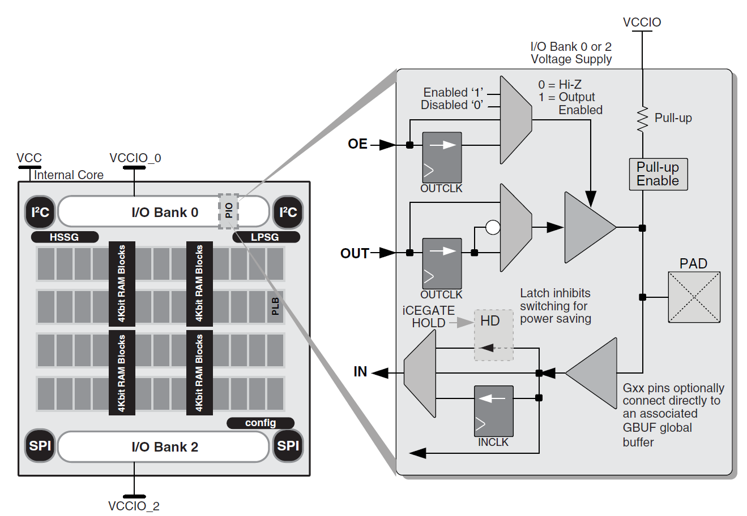
“ASIC” IO
Up to 1680 IOs/chip
Global input buffers used for clocks and reset
To Device Pin
Lattice Semiconductor iCE40FamilyHandbook.pdf pg6-7

Slide 17
Multiply/accumulator
up to ~12K per chip
running at 800MHz
2000 18x18 signed Xilinx Virtex-2
2002 DSP block Altera Stratix
Initially no accumulator, accumulators now include ALU capability and floating-point
Use pipelining for maximum speed
Multiplier shapes: 16x16, 18x18, 18x27; (3)9x9, (2)18x18 or (1)27x27
Uses: DSP, FFT, ALU

Slide 18
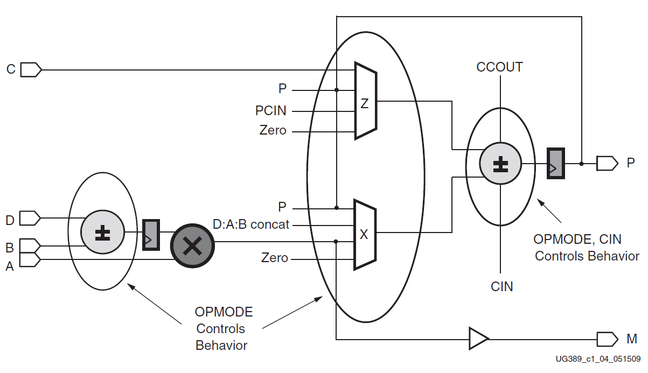
Simplified DSP slice
Xilinx Spartan-6 FPGA DSP48A1 Slice pg 17

Slide 19
SERDES (Serialize/De-serialize)
up to ~100 per chip
up to 56Gbps
2001 Source synchronous transceiver Xilinx Virtex-II
2002 SERDES Transceiver
Xilinx Virtex-II Pro
Uses:
Communication links: Fiber connections, Ethernet, PCI-express, Interlaken, etc

Slide 20
ASIC micro-processor(s)
1 to 6 per chip, 100MHz to 1.5GHz
2000 ARM 9 Altera Excalibur
2002 PowerPC Xilinx Virtex-II Pro
2010 ARM Cortex M3 Actel Smart Fusion
2010 ARM dual Cortex A9
Xilinx Zynq, Altera Cyclone V
2015 ARM quad A53 & dual R5, GPU
Xilinx Zynq Ultrascale+, Altera Arria-10
2019 ACAP Xilinx datacenter compute chip
2019 ? Intel/Altera ?
All have microprocessor peripherals
Uses: Reduce chip count, cleaner interface between uP and FPGA fabric

Slide 21
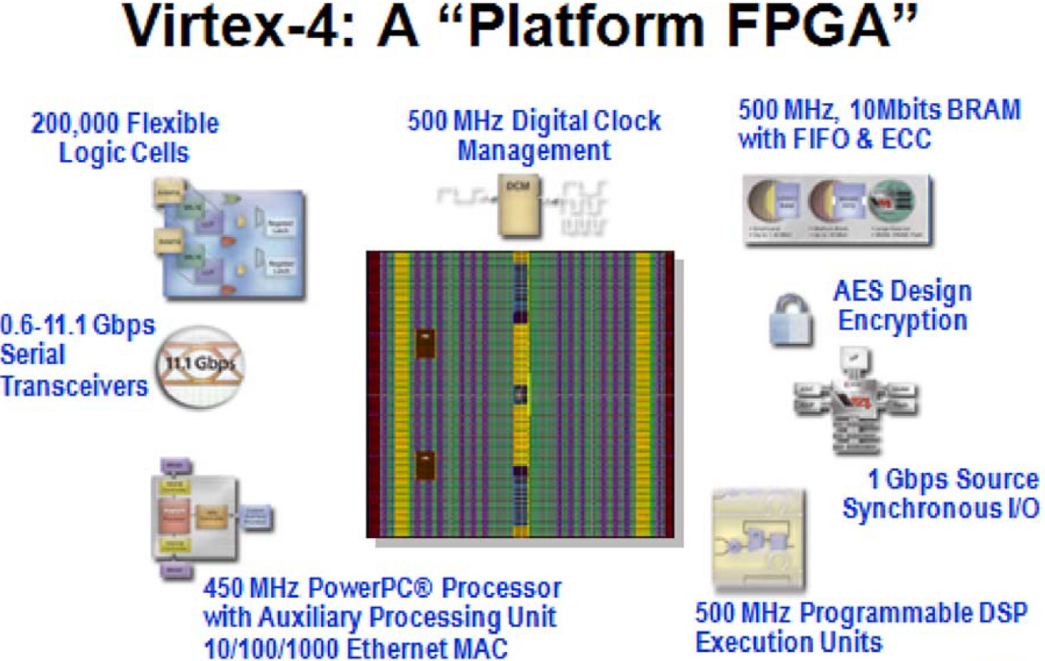
SOC chip
From: Trimberger, 2015 Proc IEEE v103 #03 pg327

Slide 22
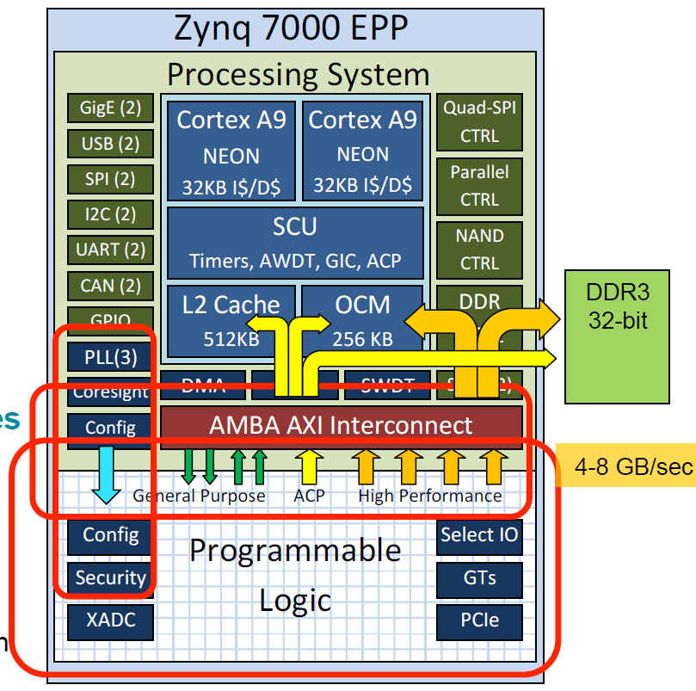
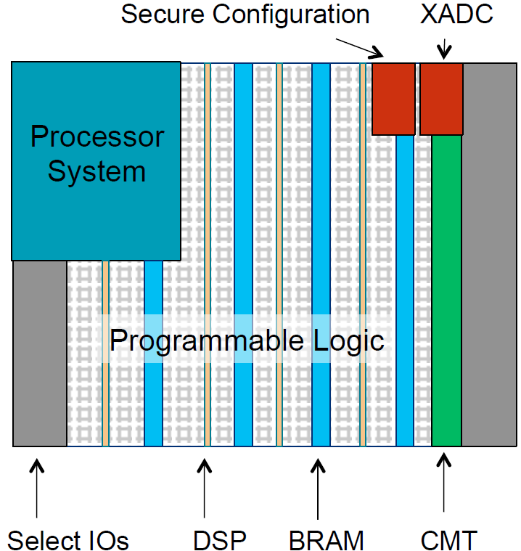
Zynq: ARM + FPGA chip
HC23.18.322.Zynq-7000-EPP-Dutta_Xilinxrevised.pdf

Slide 23
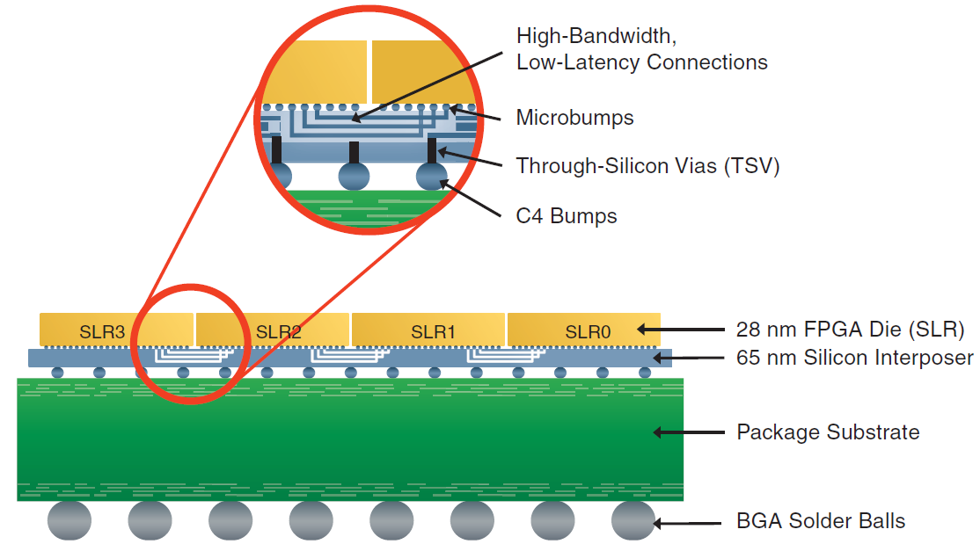
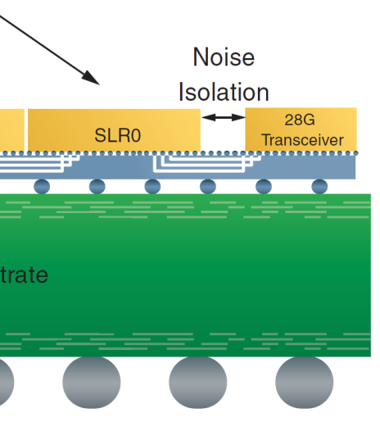
Silicon interposer (3D silicon)
2009 Multi-chip FPGA Xilinx Virtex-6
Uses: Yield improvement, reduced wiring capacitance, augmentation with SERDES, DRAM & A2D/D2A chips
Thousands of wiring channels
Xilinx white paper #380 pg 4 & 7, 2012: Stacked Silicon Interconnect Technology

Slide 24
HLS (High Level Synthesis)
“Work in Progress”
1980s VHDL & Verilog RTL
(Register Transfer Language)
2004 C, C++ or SystemC to VHDL/Verilog
Matlab to VHDL/Verilog
2011 Xilinx bought AutoESL, incorporated HLS technology into their Vivado tool.
2011 OpenCL for uP, DSP, GPU & FPGAs
Uses: Productivity
FPGA development by software engineers

Slide 25
Floating-point
2015 32-bit Add/subtract/multiply Altera Arria-10 & Stratix-10
IEEE floating-point library: exponent & mantissa size bit adjustable
Uses:
Super computer applications
Wide dynamic range DSP

Slide 26
2019 High End Processing
High performance PC: x86, 64-bit ARM, etc
DSP: the niche is evaporating/morphing
ASICs: high NRE
GPGPU (General Purpose Graphics Proc. Unit)
Originally for gaming, now used for AI apps
FPGAs (Field Programmable Gate Arrays)
As chip capacity increases, capabilities escalate

Slide 27
2019 Xilinx ACAP: Adaptive Compute Acceleration Platform
https://www.eejournal.com/article/xilinx-previews-next-generation/
HW/SW programmable engines
Probably enhanced DSP modules
https://www.youtube.com/watch?v=XMeKwtI82M8
Application and Real-Time Processors
Probably ARM or RISC-V uP
On-die network fabric
See Jan Gray’s http://fpga.org/grvi-phalanx/

Slide 28
2019 Intel/Altera:
Singularity Prosperity series of videos:
https://singularityprosperity.com/videos
The Future of Classical Computing (Heterogeneous Architecture – CPUs, GPUs, FPGAs, ASICs,...):
https://www.youtube.com/watch=2yklU69Xiuo
The GPGPU (nVidia) argument:
https://www.youtube.com/watch?v=658n_Ym8dkk
Intel has many irons in the fire, along with Microsoft, Google, …
https://www.nextplatform.com/2018/05/24/a-peek-inside-that-intel-xeon-fpga-hybrid-chip/

Slide 29
References
Three Ages of FPGAs: A Retrospective…, Steve Trimberger, Proc. IEEEE v103#3p318, 2015
www.cpe.virginia.edu/grads/pdfs/January%202016/VLSI.pdf
forums.xilinx.com/t5/Xcell-Daily-Blog/Video-The-Three-Ages-of-the-FPGA-and-the-Age-of-the-Design/ba-p/644396
Xilinx Part Family History, John Lazzaro,
www-inst.eecs.berkeley.edu/~cs294-59/fa10/resources/Xilinx-history/Xilinx-history.html
Altera History, corporate,
www.altera.com/about/company/history.html
HLS (High Level Synthesis)
en.wikipedia.org/wiki/High-level_synthesis

Slide 30
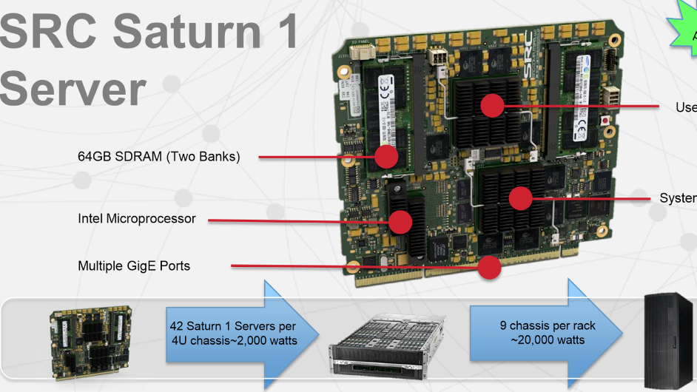
High End Applications
Typical FPGA & uP module

Slide 31
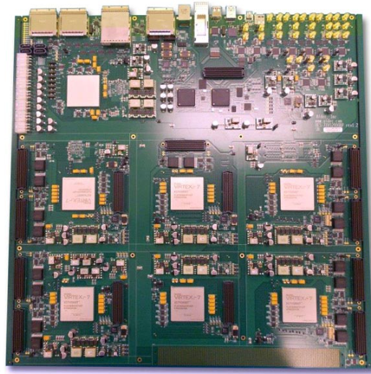
High End Applications
ALDEC HES-7
Board using
(6) Virtex-7 2000
with 1.1M LUTs
each
Used to simulate
600M ASIC gates

Slide 32
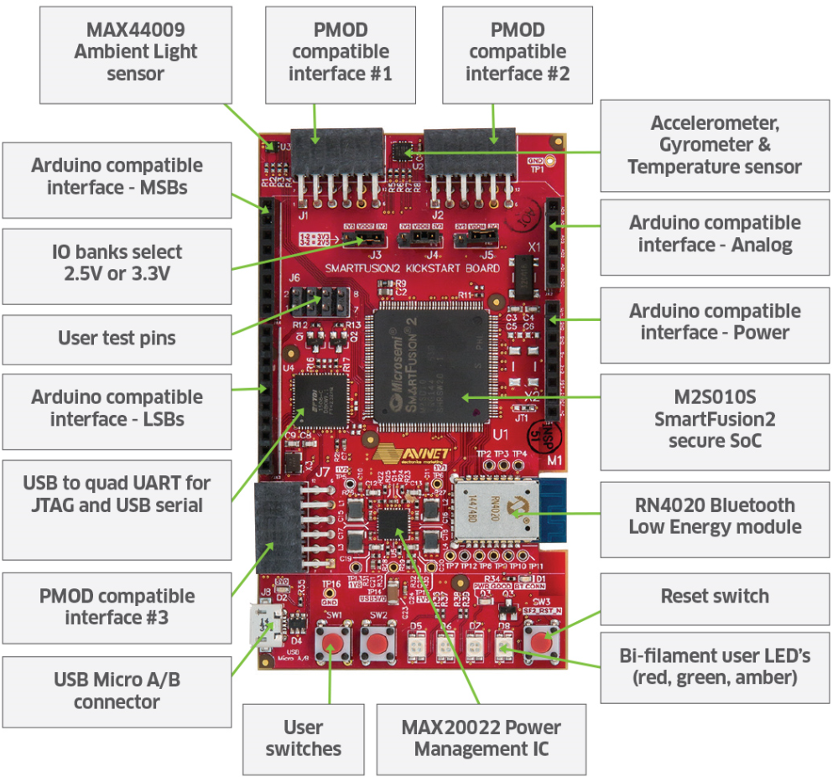
Actel SmartFusion2 KickStart Kit
Avnet
AES-SF2-KSB-G
$59.95
Has ARM
Cortex M3

Slide 33
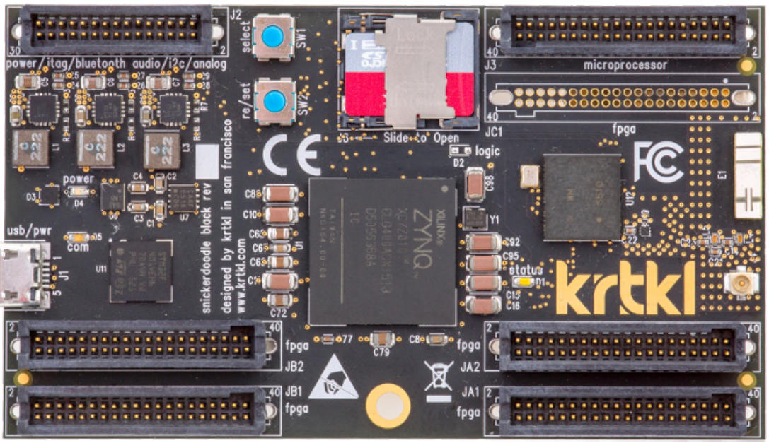
Xilinx Zynq SOC kit
Snickerdoodle with WiFi & Bluetooth $72

Slide 34
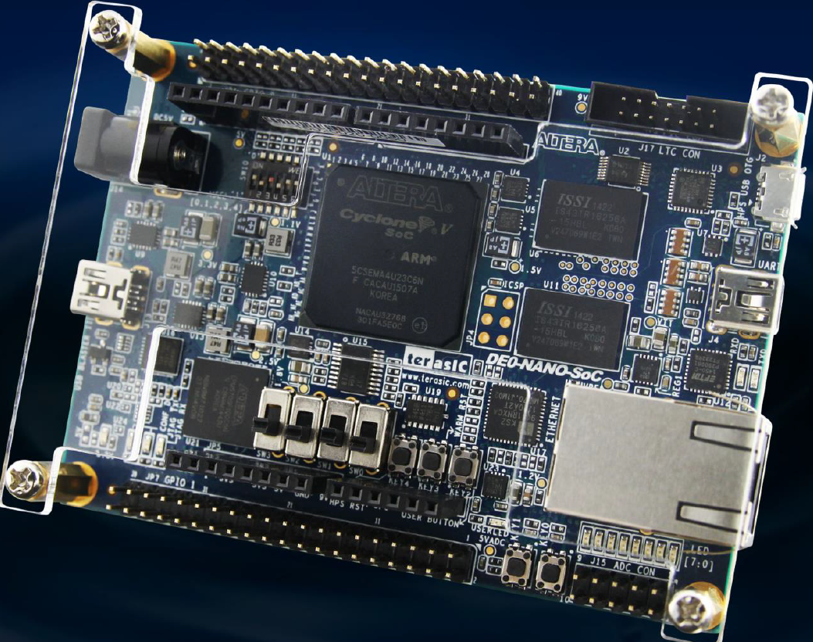
Altera Cyclone V SOC kit
Terasic
DE-0
Nano SoC
$99

Slide 35
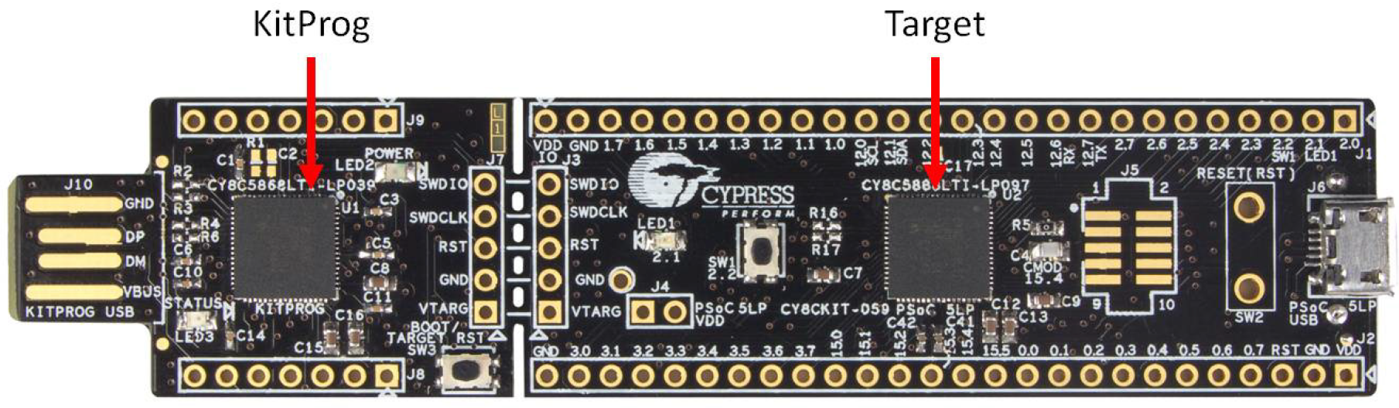
Cypress PSoC5 kit
CY8CKIT-059 for $10 with: ARM Cortex M3, Analog & Digital IO

Slide 36
IP (Intellectual Property) Pre-packaged modules, macros & generators
TTL logic equivalents (with schematic entry)
Simple macros (also with schematic entry)
Vendor free IP: soft-core processors, CORDIC, FFT, Floating-point, PCI-express, memory controllers …
Open source IP: www.opencores.org
Vendor and 3rd party non-free IP (various interfaces, soft core processors, image processing…)
Uses: save time & money

Slide 37
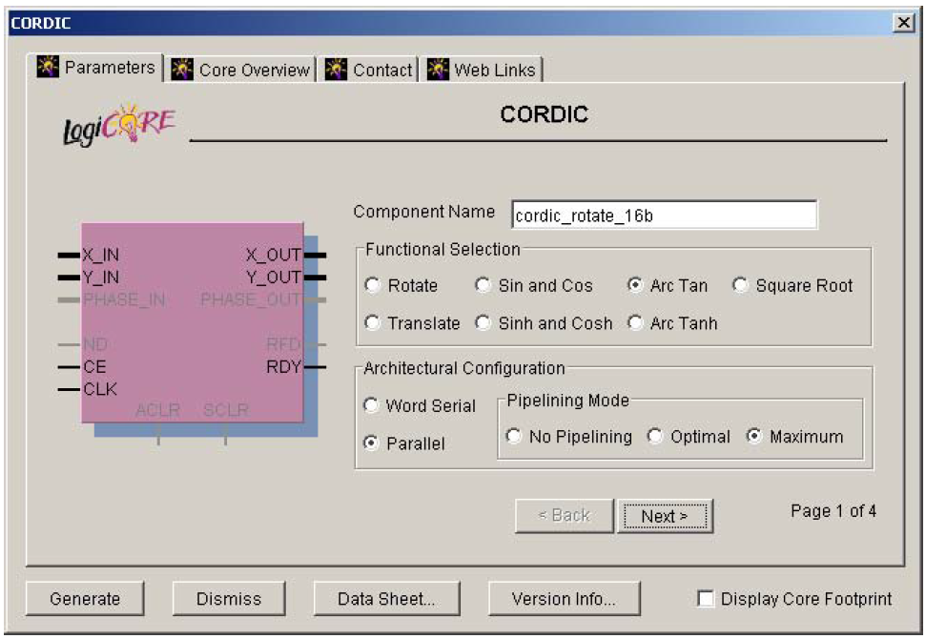
Xilinx CORDIC GUI
Ray Andraka 1998: A survey of CORDIC
algorithms for FPGA
based computers

Slide 38
Intro: Experience
PowerPC emulation of Pentium
Decided to learn VHDL 1995
AMD/Vantis/Lattice Semi
Competitive benchmarking 1998-2002
OnBoard Software/BAE Systems 2004-2012
FLR-9, IP over 1553, Weather RADAR
ROIS24_24uP
24-bit soft core processor 2016

Slide 39
FPGA Code & Test Process
Schematic capture (doesn’t scale)
Or write RTL (Register Transfer Logic) which evolved into Verilog and VHDL (1980s)
Simulate
Faster than compile/map-pack-P&R-bit-stream/download
Use test-bench
Not perfect
Compile: synthesize VHDL/Verilog to gates or FPGA primitives
Map, Pack, timing driven Place & Route
Bit-stream generation
Download & test

